Slide 1

Final Presentation
Summer 2017
Web-VR v. 1.0
Team Members
Hamilton Chevez, Pachev Joseph, Daniel Khawand, Bernado Pla, Daniel Rivero
Product Owner
Francisco Ortega
Instructor
Masoud Sadjadi School of Computing and Information Sciences Florida International University
Notes:
7 seconds.( I will select 2 best slides (i will give them extra points and students will present for CIS committee)
Greet your audience, thank them for attending your presentation, introduce yourself, introduce your project, introduce your team members, and quickly indicate what each of you did in a high-level manner, and put more emphasis on your part/contribution.

Slide 2
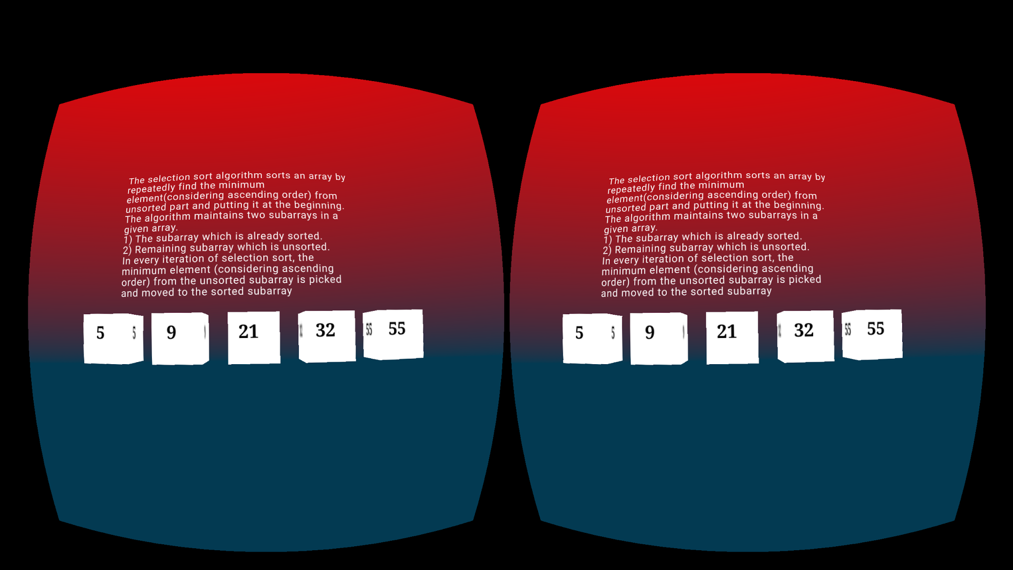
Project definition
The main focus of the project iis to visualize computer science topics through the use of augmented and virtual reality technologies
WebVR Scenes : Education - Selection Sort Scene
Notes:
10 seconds.
Introduce the problem that the whole project (in all versions) tackles with GIF or screenshot.

Slide 3
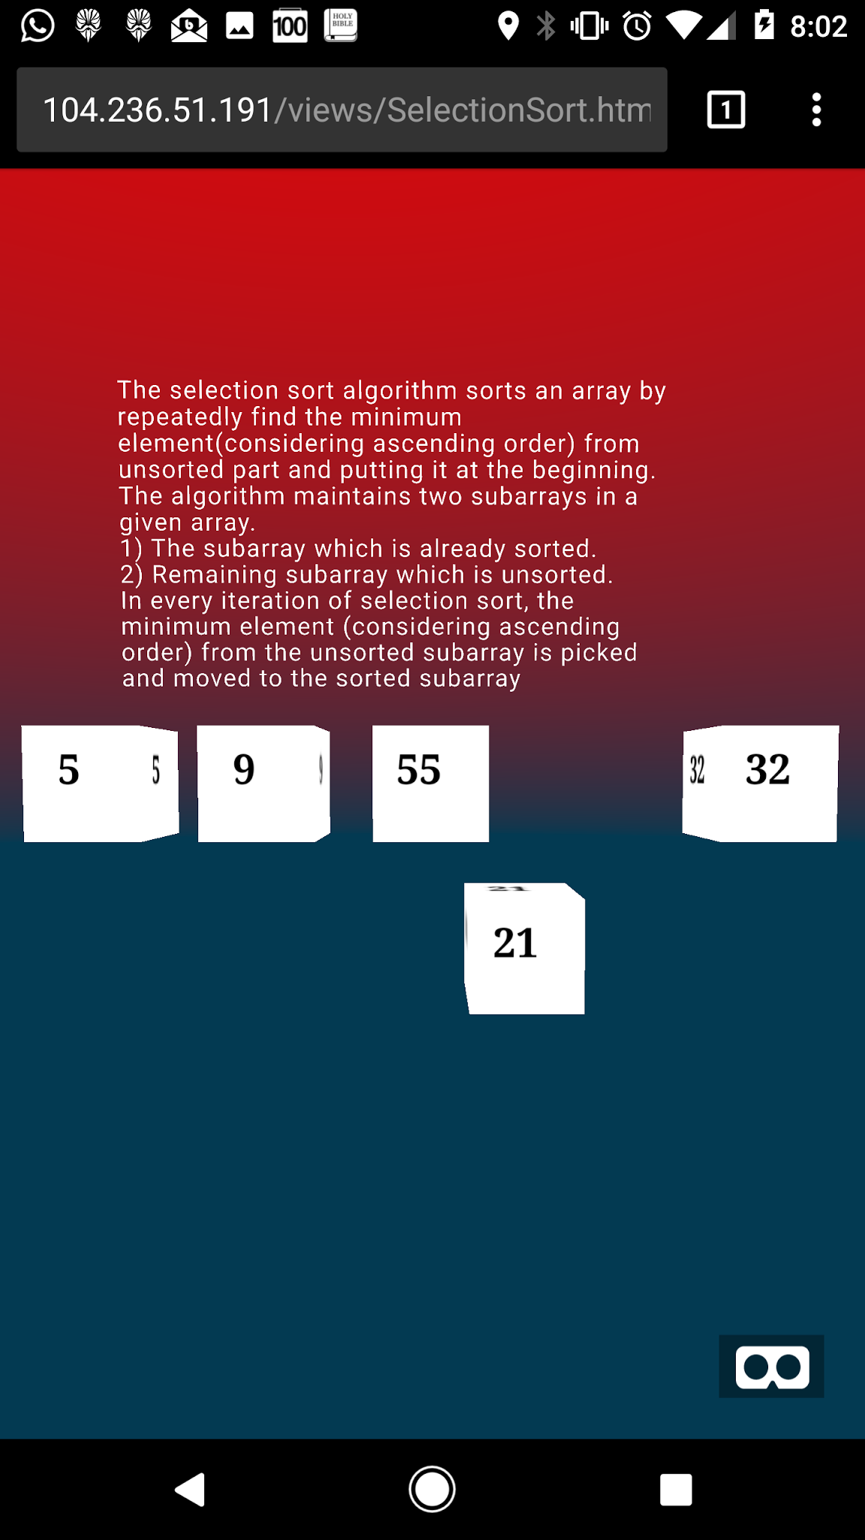
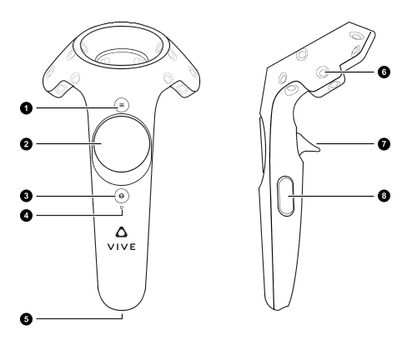
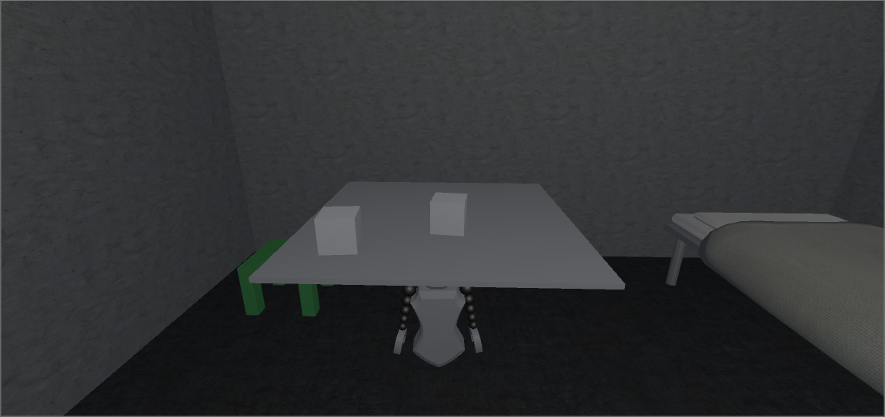
Project definition
Three different teams worked together to bring the project to life:
Education team focused on aiding in increasing the retention rate of Computer Science students.
Video Game team focused on incorporating programming concepts a virtual reality video game
Input team focused on integrating with different applications and support a variety of input devices such as virtual reality devices.
Notes:
20 seconds.
Introduce the problem that the your project (in new version) tackles with GIF or screenshot.

Slide 4
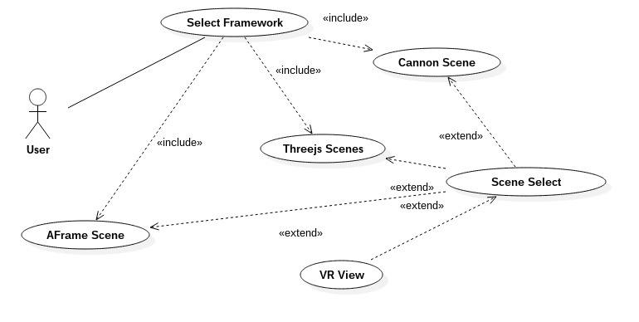
Requirements: Use Cases
System Use Case For Web-VR Education
Notes:
5 seconds
Show the Use Case Diagram for the whole project. Highlight your use cases.

Slide 5
System Design: Architecture
Notes:
20 seconds
System design: Highlight the parts that you contributed to them.
1. System decomposition; identify the architecture patterns used
2. System deployment – h/w and s/w requirements

Slide 6
Minimal Class Diagram
Notes:
10 seconds.Minimal class diagram. Highlight the classes that you created/modified
Identify the design patterns used (one or more slides).

Slide 7
User Stories
2.
3.
4.
5.
Notes:
5 seconds.
List the user stories that you worked on them.(put in order of importance). Stay focused on the parts that you have been working.

Slide 8
User Story #1
Notes:
60 seconds
The tile of user story
The most important user story you worked on it. You have to describe this one very well and be proud of that.
Please present and show the complexity of your work, code, algorithms, and technical challenges and technologies you have used. (you could use screenshot if you want. Visual presentations are better than text presentation)
Go into the details of the most important/significant tasks using bullet lists or visual graphs or state chart diagram
Sequence Diagram for this user story is mandatory (in another separate page if required)
Demo using screenshots or GIF (in another separate page if required)

Slide 9
User Story #2
Notes:
20 seconds
The tile of user story
Please present and show the complexity of your work, code, algorithms, and technical challenges and technologies you have used. (you could use screenshot if you want. Visual presentations are better than text presentation) - Go into the details of the most important/significant tasks using bullet lists or visual graphs or state chart diagram - Demo using screenshots or GIF (in another separate page if required)
Sequence Diagram for this user story is optional

Slide 10
User Story #3
Notes:
20 seconds
The tile of user story
Please present and show the complexity of your work, code, algorithms, and technical challenges and technologies you have used. (you could use screenshot if you want. Visual presentations are better than text presentation) - Go into the details of the most important/significant tasks using bullet lists or visual graphs or state chart diagram - Demo using screenshots or GIF (in another separate page if required)
Sequence Diagram for this user story is optional

Slide 11
User Story #4
Notes:
20 seconds
The tile of user story
Please present and show the complexity of your work, code, algorithms, and technical challenges and technologies you have used. (you could use screenshot if you want. Visual presentations are better than text presentation) - Go into the details of the most important/significant tasks using bullet lists or visual graphs or state chart diagram - Demo using screenshots or GIF (in another separate page if required)
Sequence Diagram for this user story is optional

Slide 12
User Story #5
Notes:
20 seconds
The tile of user story
Please present and show the complexity of your work, code, algorithms, and technical challenges and technologies you have used. (you could use screenshot if you want. Visual presentations are better than text presentation) - Go into the details of the most important/significant tasks using bullet lists or visual graphs or state chart diagram - Demo using screenshots or GIF (in another separate page if required)
Sequence Diagram for this user story is optional

Slide 13
Test Suites and Test Cases
Notes:
10 seconds
A description of verification process and Test Suites and Test Cases for one of the use cases.
1 One sunny day and one rainy day for the implemented use cases (one or more slides).
2 Automated test scripts for the implemented use cases (if any) (one or more slides).

Slide 14
Summary
Summary
contact information
Questions?
Thank You!
The logos of all technologies you have used
Notes:
10 seconds
Summarize your contribution, mention your effort for Scrum, Mingle, Github, Google Drive Documentation and minutes
Include your contact information
Ask if anyone has any questions for you.
Thank your audience

